Slide 1
Restricting Data

Slide 2
Another SELECT Statement Clause
SELECT [DISTINCT] {*, column [alias], …}
FROM table
[WHERE condition(s)];
The WHERE clause allows you to restrict what data will be returned by the execution of the query.
You cannot refer to an alias in the WHERE clause.

Slide 3
The WHERE Clause
SELECT ename, job, deptno
FROM emp
WHERE job = ‘CLERK’;
ENAME JOB DEPTNO
---------- --------- ---------
SMITH CLERK 20
ADAMS CLERK 20
JAMES CLERK 30
MILLER CLERK 10
Be careful, although SQL is case insensitive, string literals are case sensitive.

Slide 4
Comparison Operators
= (Equal to), <> (Not equal to, < (Less than), > (Greater than), <= (Less than or equal to), >= (Greater than or equal to)
BETWEEN..AND (Between two values inclusively)
IN (list) (Match any values in the list)
LIKE (Match a pattern)
IS NULL (Test for null)

Slide 5
The BETWEEN Operator
SELECT ename, sal
FROM emp
WHERE sal BETWEEN 1000 AND 1500;
ENAME SAL
---------- ---------
WARD 1250
MARTIN 1250
TURNER 1500
ADAMS 1100
MILLER 1300
You must specify the lower limit first.

Slide 6
The IN Operator
SELECT ename, job
FROM emp
WHERE deptno IN (10, 20, 40);
ENAME JOB
---------- ---------
SMITH CLERK
JONES MANAGER
CLARK MANAGER
SCOTT ANALYST
KING PRESIDENT
ADAMS CLERK
FORD ANALYST
MILLER CLERK

Slide 7
The IN Operator (cont)
SELECT ename, job, sal
FROM emp
WHERE job IN (‘CLERK’, ‘ANALYST’);
ENAME JOB SAL
---------- --------- ---------
SMITH CLERK 800
SCOTT ANALYST 3000
ADAMS CLERK 1100
JAMES CLERK 950
FORD ANALYST 3000
MILLER CLERK 1300

Slide 8
The LIKE Operator
The LIKE operator uses wildcards to specify a pattern.
A % represents a sequence of zero or more characters.
A _ represents a single character.
SELECT ename
FROM emp
WHERE ename LIKE ‘S%’;
ENAME
----------
SMITH
SCOTT

Slide 9
The LIKE Operator (cont)
You can use the ESCAPE option if you need to look specifically for one of the wildcards. In the example below, we are looking for any department name with an underscore.
SELECT *
FROM dept
WHERE dname LIKE ‘%\_%’ ESCAPE ‘\’;

Slide 10
The IS NULL Operator
You cannot use the = operator to check for a null field. You have to use the IS NULL operator instead.
SELECT ename, mgr
FROM emp
WHERE mgr IS NULL;
ENAME MGR
---------- ---------
KING

Slide 11
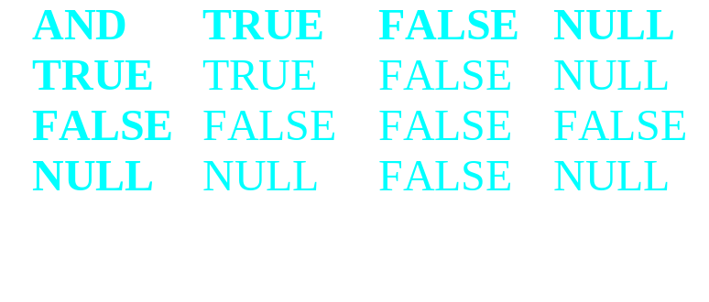
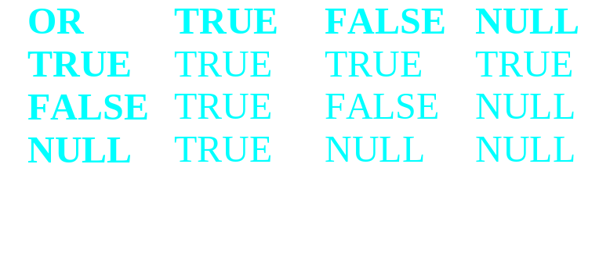
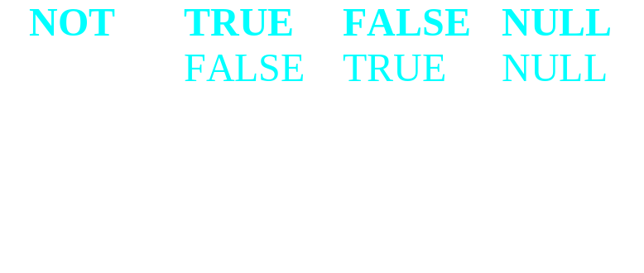
Logical Operators
There are three logical operators: AND, OR, NOT.
The one to watch out for, obviously is the NULL.
Rules of precedence: All comparison operators, NOT, AND, then OR. Change the order with parenthesis.

Slide 12
Another SELECT Statement Clause
SELECT [DISTINCT] {*, column [alias], …}
FROM table
[WHERE condition(s)]
[ORDER BY{column, expr}[ASC|DESC]];
The ORDER BY clause allows you to sort the results returned by the query. By default, the ORDER BY clause sorts in ascending order.
You can also sort by a column that doesn’t appear in the SELECT clause.

Slide 13
The ORDER BY CLAUSE
SELECT ename, job, deptno, hiredate “Hire Date”
FROM emp
ORDER BY “Hire Date” DESC;
ENAME JOB DEPTNO HIREDATE
---------- --------- --------- ---------
ADAMS CLERK 20 23-MAY-87
SCOTT ANALYST 20 19-APR-87
MILLER CLERK 10 23-JAN-82
JAMES CLERK 30 03-DEC-81
FORD ANALYST 20 03-DEC-81
...

Slide 14
The ORDER BY CLAUSE (cont)
SELECT ename, deptno, sal
FROM emp
ORDER BY deptno, sal DESC;
ENAME DEPTNO SAL
---------- --------- ---------
KING 10 5000
CLARK 10 2450
MILLER 10 1300
SCOTT 20 3000
FORD 20 3000
...

Slide 15
The ORDER BY CLAUSE (cont)
When sorting in descending order, any nulls in that column will be shuffled to the top. In ascending order, they are shifted to the bottom.

